Slide 1




LEA Global
Digitalisation of indirect tax
  April 2023

Slide 2

Agenda
Avalara session
Topics
  Intro – about us (5min)
  Discussion – questions for you (15min)
  Key trends in the digitalisation of indirect taxes (20min)
  How firms can adapt + how we can help (5min)
  Appendix: our offerings

Slide 3
Intro
  About Avalara

Slide 4


Intro
About me
Background
  10+ years experience within global VAT / GST and customs in big-4
  Worked in New Zealand, Malaysia, in the Middle East and London
  Experience in international VAT/GST consulting, incl. VAT/GST implementation projects in Malaysia and the Middle East
  Established indirect tax compliance processes for a boutique consultancy firm
  Worked on indirect tax process improvement, technology and change management projects
  Enrolled barrister & solicitor in New Zealand
  Chris Park
  Senior Strategic Alliances Manager (Accounting) EMEA
  chris.park@avalara.com

Slide 5

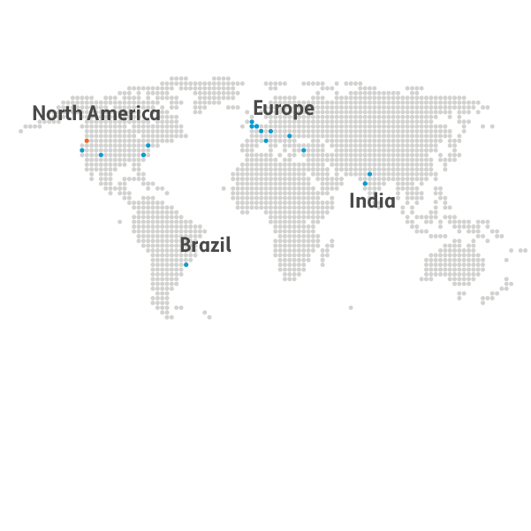
Intro
About Avalara
Key Facts and Figures
In a nutshell
We are a tax technology business with a
focus on transactional taxes.
More than 31 million documents / certificates managed by Avalara in 2022
More than 1,200
signed partner integrations
In operation
since 2004
Global Offices
17 offices
4,400+ employees
39.6 billion AvaTax API calls were made by customers in 2022
More than 5.2 million returns prepared by Avalara in 2022
Serving 30K+ customers from
95 countries

Slide 6
Discussion
  What does your VAT practice currently look like?

Slide 7
Discussion
What does your current VAT practice look like?
What are some of the biggest challenges in supporting clients in this area?
What does your current tech stack look like for this team?
What kind of automation/process improvement are clients looking for in the indirect tax space?

Slide 8
Digitalisation
  Key trends in the digitalisation of indirect taxes

Slide 9






Digitalisation of indirect taxes
ITX compliance
  The traditional indirect tax compliance model is changing
Continuous transaction controls
  The future process will involve continuous transaction controls (incl. pre-clearance models)
Tax audits
  The way tax authorities will audit businesses is changing
E-invoicing
  All businesses will have standardised AP/AR data that tax authorities can interpret
Transaction tracing
  Every transaction (granular data) could potentially be received and stored by tax authorities
Data analytics
  Tax authorities are actively digitalising their own toolkits – data analytics, exception reporting, AI, machine learning
Notes:
So what do all of these changes mean for the tax function, and for us as tax professionals?
IMPLICATIONS
Traditional ITX model/lifecycle is changing.
Historically: raise + receive tax invoices. At period end, summary VAT return prepared, with aggregated numbers.
This doesn’t provide the tax authority any real comfort, any data, visibility. It’s also months after the transaction took place.
Doesn’t give the tax authority any opportunity to identify errors or fraud.
New model: receiving granular data on a transaction by transaction basis, real time.
Italy – the tax authorities actually send the invoice to the customer.
The way tax authorities carry out audits will change.
Currently: in person, sample documents, play around with excel.
New model: tax authority has every single transaction in a consistent format across all businesses, industries, regardless of source system. They can run validation checks at the time the invoice is issued. They can also run AI data analytics, exception reports, apply ML to get smarter, more targeted. To focus their efforts on high-risk businesses.
One of the big drivers for e-invoicing. That’s why its tax authorities pushing for something that is ostensibly a billing or finance requirement.
EU VAT gap last year = 134b EUR.

Slide 10
VAT in the Digital Age (ViDA) summary of proposals
E-invoicing & Digital Reporting
Single VAT Number
Platform Economy
harmonised common standard for e-invoicing across EU
gradual introduction of obligatory e-invoicing across EU
issuing invoices should be administered only via state-operated/certified system(s) with full data protection ensured
online reporting of cross-border trade data including efficient and secure data processing for detection of fraud.
reduce the number of VAT registrations required to trade in the EU
reduce cost and administrative burden
extension of OSS and IOSS
movement of goods between warehouses / fulfillment hubs
extension of reverse charge (so customer can self-account for VAT due)
clarification of the nature of services provided by a platform
clarification on customer’s VAT status to help define the place of supply in cross-border transactions
deemed supplier regime for digital platforms
level-playing field between traditional and platform economy
streamlining of record-keeping obligations
Notes:
E-INVOICING
Effective 1 January 2028
Mandatory for all intra-EU B2B supplies
Invoices will need to be in a structured electronic form (i.e. no PDFs), and meet the European standard.
Countries can have other formats/standards, but the European specification must be accepted.
No pre-clearance by tax authorities
Must be issued within 2 working days of time of supply.
“buyer consent” to be removed – this means supplier doesn’t need agreement from recipient to issue e-invoice.
Countries may bring in additional mandates (e.g. Spain, France, Belgium – others will likely follow) to include domestic transactions – formal derogations no longer required.
Additional tax invoice requirements – must also include:
IBAN
Due date for payment
No longer possible to issue summary invoices covering multiple supplies during the same calendar month.
Countries may request derogations to implement ahead of change (like Germany)
End of EC sales lists – transactional data will need to be reported to relevant national tax authority – they will share within EU’s new central database.
SINGLE VAT NUMBER
OSS – currently only B2C.
1 Jan 2025 – marketplaces will be deemed supplier for all goods (both EU + non-EU) for B2B and B2C.
OSS will also include domestic B2C supplies of goods.
IOSS – customs authortieis will be granted access to IOSS registered trader to prevent abuse/tax evasion.
Mandatory use of IOSS for deemed suppliers
REVERSE CHARGE ON B2B
1 January 2025
Extension of reverse charge for B2B supplies.
MOVEMENT OF OWN GOODS
1 January 2025
New special scheme to report own movement of goods
Arrival of transferred goods no longer treated as intra-community acquisition (VAT exempt)
Taxpayers can opt into this scheme (where they are established for EU-based, or where country of departure of goods for non-established)
special monthly return showing goods transferred incl. value of transfers, and breakdown of shipments from each member state of departure.
PLATFORM ECONOMY
1 January 2025
Deemed platform liability for short term accommodation (max 45 days of uninterrupted rental) + passenger transport.
Platform liable for VAT as deemed supply.
B2B and B2C.
Only where underlying supplier is not registered for VAT.
Similar to marketplace rules for ecomm.
OSS can be used
VIDA NEXT STEPS
Still needs unanimous approval from Eu27.
Subject to change/amendemnts
Feedback period closed in March 2023
e-invoicing specification still being developed.

Slide 11

What does e-invoicing mean for us
Why is tax more important with e-invoicing?
Both sides of a transaction
can be seen and compared
Mismatches no longer an option,
need to ensure
  Sales v Purchase e-invoice
  output VAT vs input VAT
  supplier vs customer
  e-invoicing vs e-reporting
  authenticity of supplier – evidenced by
  digital signature
  authenticity of customer – evidenced by VAT number / other master-data
No master data errors – clean, accurate and consistent
No transposition errors – automated posting based on e-invoice
No exchange rate discrepancies – foreign currency invoices must use fx rate as per e-invoice
No errors in tax – correct VAT liability and rate charged at point of sale / invoice issue
Notes:
RECAP
Look at what we’ve discovered so far:
Increase in digitalization mandates
Technology is going to be non-negotiable to comply with these requirements
Means granular, real-time data for tax authorities
Sophisticated audits
WHY IS TAX MORE IMPORTANT UNDER E-INVOICING
- Tax authority can now see both sides of a single transaction. Compare sales vs purchase side.
Output VAT declared, against the input VAT deduction.
We are going to see matching off between supplier vs customer reporting.
Traditional reconciliations: VAT return boxes vs GL balances.
New: comparisons, reconciliations between e-inv, data submitted in any parallel reporting requirement.
They can carry out diligence on identify of the invoice issuer – more digital signatures.
They are more likely to be request you to evidence authenticity of both supplier + customer. This will put real pressure on the master data held.
MISMATCHES/DATA TRANPOSITION IS NO LONGER AN OPTION
Clean data is definitely a requirement.
You won’t have time to fix it after month-end.
Current model: receiving manual invoices/PDFs, that are manually keyed in = possible transposition errors + discrepancies e.g. with exchange rates.
E.g. under VAT legislation, you can raise an invoice in any currency. When VAT applies, it must be shown in local currency.
Typically, businesses will book the invoice in the document currency (tax converted using different FX rate). Under e-invoicing this is no longer an option – this would be flagged by a tax authority.

Slide 12









Continuous
Compliance
Future
Real-time
E-invoice submission
E-invoice
receipt
Tax
Determination
& validation
Government interfaces
Additional
transaction
collection
VAT treatment
& Tax coding
Identity and Trust
Cross border,
imports, T&E, B2C, adjustments…
Transaction
ERP
E-commerce
EPOS
Return &
E-reporting
Preparation
Master & Transactional data
VAT, ESL
Intrastat VAT
books SAF-T
Archiving
& retrieval
Compliance
checking
Audit
readiness
Exception
reporting and analytics
Return
submission
Reconciliation
E-submission
E-invoice to VAT
Counterparty Intrastat
to VAT GL to VAT
Notes:
As a business, we started to look at these developments, and think about what it mean for us.
We think the overall impact is = businesses need to move to being continuously compliant, moving away from post it for now, fix it later.
MASTER DATA (9 oclock)
Traditionally where you start.
Correctly ID the nature of the transaction
In master data – supplier, customer, items/products.
TAX TREATMENT
Then we need to determine the tax implications of that transaction.
How businesses do this varies -some use tax engine, some manually. More businesses look to automate this esp. for those that have automated sales (e.g. web sales), and when real-time compliance becomes more important.
E-INVOICING
Then moving to e-invoicing (where relevant). Includes submission, as well as receipt.
TRANSACTION INFO
Any info not being collected e.g. cross-border imports, T&Es, any other adjustments needs to be compiled.
PREPARATION OF FILINGS
Different approaches:
excel.
Automated it managing in-house
Shared service centres
Outsourcing it.
CHECKS
After preparing returns, checks:
Exception reporting analytics, checks, trending etc.
Depends on how you do this depending on whether they’re using tools, or outsourcing it.
RECONCILIATION
Not just traditional GL balance to VAT returns, intrastat to VAT, but also
E-invoice to VAT.
Intercompany
SUBMISSION
What format, what kind of file.
ARCHIVE
In accordance with the requirements, then being able to retrieve this in an efficient way for historical reviews/audits.
TODAY
Not everyone is here, but we will start to see this cyclical real-time process.

Slide 13
The sales process
An alignment with indirect tax
QUOTE
SALES
ORDER
BILLING
SALES
E-INVOICE
SALES
E-CREDIT
POSTING
SALES LEDGER
GL
TAX REPORTING
Compliance in real time
Good customer experience
Higher conversion
Process benefits
Automated processes
ensure accurate transaction
& master data
Compliance in real time
Real time declaration to TA reduces audits, fines and penalties
Valid invoices will not be rejected by TA
Counterparty reconciliation match
Process benefits
Improved cashflow as lower
invoice/ tax disputes
Reduction in printing and sending costs
Compliance in real time
Properly tax coded transactions post accurately
Real-time visibility into tax and transactional data
Compliance in real time
Properly tax coded transactions ensures returns accuracy
Confidence in pre-populated returns
Process benefit
Reduction in compliance effort
Notes:
Not all doom and gloom.
Lets just look at sales process today.
What are some of the benefits that can come out of this:
Quote/sales order – if you’re doing the determination right here, you’ll probably have a better customer experience – final correct price.
GL/tax reporting – correct tax codes = returns accuracy. In some countries – we are seeing prepopulated tax returns (e.g. in India) so important to ensure data + tax determination is correct first time.
Process benefit = reduction in compliance effort, if most data is clean, right first time, less time responding to tax authorities.

Slide 14
How can VAT teams adapt to these changes?
  Incl. ways we can help

Slide 15
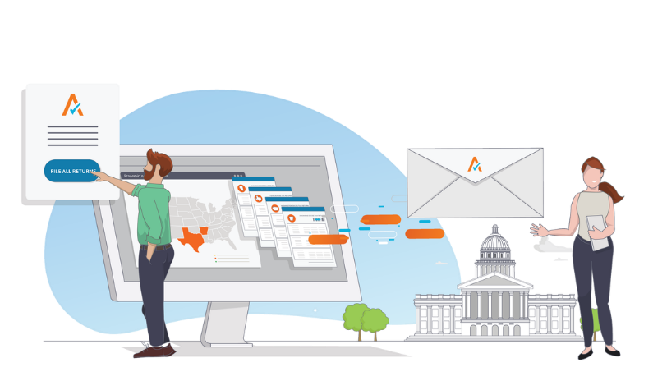
How can VAT teams adapt
Incl. ways we can help
Staying up to date on changes, industry trends
Avalara blog on indirect tax topics
Free webinars – both live and on-demand
Other resources on our website, incl. international tax rates, whitepapers and more.
Tax research platform for sales tax + insurance (VAT content being developed), incl. the ability to ask questions
Empowering your teams with solutions to reduce manual work
Identifying + quantifying pain points, finding the right solution to address these
Automated VAT/GST compliance platforms
Customs commodity code classification solutions
Sometimes the solutions aren’t tax-specific!
Building a well-rounded team
Successful tax teams have individuals with varying skillsets that can be combined to deliver stronger, more holistic offerings.
Skillsets may include proficiency with data visualisation tools, data analytics/transformation tools etc.
Consider how this feeds into your recruitment strategy

Slide 16

How can VAT teams adapt
Incl. ways we can help
Implementing solutions
Building tax technology capability within your firm
Getting your teams trained on how to implement technology solutions for your clients
Referring work
Knowing + focusing on your strengths
When appropriate, referring within the LEA global network + affiliate network

Slide 18
Appendix
  Our offerings

Slide 19




Avalara Products – across lifecycle
Registration
Classification
Determination
Invoicing
Returns
Indirect Tax Registrations
VAT registrations
GST registrations
Fiscal representation
Sales & use tax registrations
US business license registrations
Product Classification
HS / commodity code classification
Import VAT + customs duties
Self-serve classification portal + conversational API
AvaTax Global
Tax Engine
Sales & use tax
VAT/GST
Customs duties
Insurance
premium tax
Excise (US only)
Avalara
E-Invoicing
B2C, B2B, B2G
e-invoicing
Real-time reporting
Real-time clearance
QR codes
PDF creation
Peppol
Avalara reporting and compliance
SaaS VAT Reporting
Managed VAT Reporting service
VAT, GST, SUT returns
ECSLs, Intrastat
Ledgers, SAF-T
US 1099 filings
77 countries served by Avalara VAT Registration
Avalara Item Classification offers HS code support for 180+ countries
33.9 billion AvaTax API calls made by customers
in 2021
Support for e-invoicing in 60+ countries.
Avalara processed and filed more than 4.1 million returns in 2021

Slide 20


Avalara – other products
Documents
Research
Transfer pricing
TP document solutions for accountants
TP document solutions for businesses
Avalara Tax research
Comprehensive content on sales and use taxes
Insurance tax research database
Expanding VAT content for Europe
Documents incl. benchmarking analysis produced in OECD or US standards
Notes:
Also have launched a transfer pricing solution.
Solutions/services for both businesses + accountants.
Let me know if you’d like to learn more about any of these solutions, Happy to speak after.

