Slide 1



LEA Global
Global Consulting Marketplace Update
  April 27-29, 2023

Slide 2



LEA Vision
  GLOBAL CONSULTING MARKETPLACE
Access to unique and specialized capabilities
LEA VISION
To be known as the most collaborative global alliance
COLLABORATION
Creating opportunities for members to work together
Notes:
LEA VISION
To be known as the most collaborative global alliance
COLLABORATION
Creating opportunities for members to work together to bring solutions to clients and experiences to our people
GLOBAL CONSULTING MARKETPLACE
Access to unique and specialized capabilities and expertise that can be leveraged by other firms
We created the GCM to provide members with another sales channel to develop opportunities and grow your business.

Slide 3
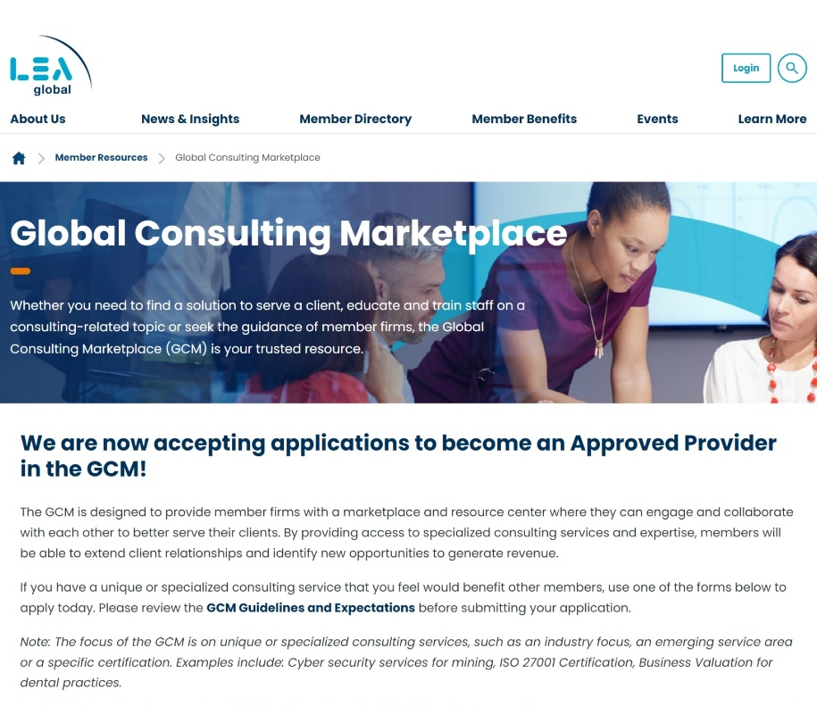
GCM Site Is Now Live!
Launched Feb. 7
Notes:
The site is now live and we need your help to populate it by submitting an application to become an Approved Service Provider.

Slide 4







GCM Roadmap
Implementation – Phase II
Review and approve provider submissions
Create assets and resources
Populate site
Perform user experience testing and obtain feedback
Member webinar/training demo – educate on why and how to use the site
Member communication – promote usage of site, highlight success stories
Monitoring, Evaluation and Development
Monitor and evaluate the process
Assess the project satisfaction
Analyze the return
Development and improvement
We are currently in this phase
Build Phase
Build platform
Perform user experience testing
Member communication – peak interest in GCM (overview of site and value to members)
Launch – Phase I
Site rollout
Member communication – announce and encourage provider submissions
Design Phase
Identify platform requirements, vetting criteria and guidelines
Research and select technology platform
Discovery Phase
Surveys, interviews and steering committee selection
Notes:
We are currently in the implementation phase, and are reviewing and approving service provider submissions.

Slide 5

  Service Provider Criteria

Slide 6



Service Provider Criteria
Unique or specialized consulting service
offering
Technical expertise in the specialty area
Dedicated resources in the specialty area
Clear track record of high performance
Capacity and desire to serve Members
Industry Focus
Emerging Service Area
Specific Certification

Slide 7
Consulting Offering Matrix
FINANCIAL ADVISORY SERVICES |  | MANAGEMENT CONSULTING SERVICES |  | TRANSACTION ADVISORY |  | TECHNOLOGY CONSULTING
CFO-Led Services |  | COVID-19 Business Recovery |  | Business Restructuring & Bankruptcy Consulting |  | CIO/CTO As A Service
Financial Process Improvement |  | Health Care Consulting |  | Due Diligence |  | Digital Advisory Services
Interim Controllership & Financial Leadership |  | HR Consulting |  | Merger or Acquisition Services |  | Enterprise System Selection
IPO Readiness |  | International Business |  | Valuation |  | Infrastructure Solutions
Restructuring Services |  | Strategic Marketing |  |  |  | Strategic IT Consulting
RISK ADVISORY SERVICES |  | FORENSIC & LITIGATION |  | OUTSOURCING SERVICES
Anti-Money Laundering |  | Forensic Accounting |  | Internal Audit Co-Sourcing/Outsourcing
Cybersecurity & Digital Forensics |  | Fraud & Forensics Investigations |  | Managed Services
Data Privacy & Compliance |  | Litigation & Dispute Consulting |  | Outsourced Accounting
Internal Audit Co-Sourcing/Outsourcing |  |  |  | Outsourced CFO
ISO 27001 Certification
Sarbanes-Oxley Compliance
System Organization Controls – SOC 1, 2 & 3
Technology Risk
Please note: This list is not intended to be all-inclusive of the various consulting/advisory service offerings.
Notes:
We are looking for service providers who offer unique or specialized consulting services – that could be an industry focus, emerging service area or specific certification.

Slide 8

Service Provider Application Timeline
Submission Deadlines
Qtr. 1: Jan. 31
Qtr. 2: Apr. 30
Applications Reviewed By
Qtr. 1: Feb. 28
Notification to Members By
Qtr. 1: Mar. 15
Qtr. 3: July 31
Qtr. 4: Oct. 31
Qtr. 2: May 31
Qtr. 3: Aug. 31
Qtr. 4: Nov. 30
Qtr. 2: June 15
Qtr. 3: Sept. 15
Qtr. 4: Dec. 15
Applications will be reviewed and approved on a quarterly basis.
Notes:
Applications will be reviewed and approved by the Steering Committee on a quarterly basis. We are currently in the first quarter review process.

Slide 9

Benefits to You and Your Firm
Extend client relationships
Position your firm as a one-stop resource
Generate additional revenue
Develop your people
Serve clients confidently

