Slide 1
Section 174
Rome
April 2023

Slide 2
This presentation contains general information only, does not render accounting, business, financial, investment, legal, tax, and is provided solely for the purpose of enhancing knowledge on tax matters. It does not constitute professional advice as it does not account for any specific taxpayer’s facts and circumstances and should not be used as a basis for any decision or action that may affect your business or clients. Before making any decision or taking action that may impact your business or clients, you should consult a qualified US tax advisor No representation or warranty (express or implied) is given as to the accuracy or completeness of the information contained in this document, and neither LEA or its affiliates shall be responsible for any loss sustained by any person who relies on this presentation.

Slide 3
Agenda
History of IRC Section 174
Current Issue
Examples

Slide 4
IRC Section 174 – History

Slide 5
What is IRC 174?
Expenditures incurred in connection with the taxpayer’s trade or business which represents research and development costs in the experimental or laboratory sense.
Expenditures related to activities intended to discover information that would eliminate uncertainty concerning the development or improvement of a product.

Slide 6
History
1937 – IRC 162 introduced which allows for the deduction of ordinary and necessary expenses incurred while carrying on a trade or business.
  Must have an active trade or business to receive a deduction.
  General capitalization provision was in place for any payment that increases the value of property (broad capitalization classification issues under IRC 263(a)).
1954 – Re-write of the internal revenue code to our current number system. Addition of IRC 174 to clarify deduction of research and experimentation cost.
  Intended to clarify whether R&E expenses were deductible (IRC 263(a) capitalization clarification).
  Carrying on business issue kept going.

Slide 7
History
1980 – Congress finally delt with the carrying on business issue. IRC 195 was created to clarify what you are required to capitalize pre trade or business.
  Specifically excludes IRC 174 from capitalization
Up until 2022, IRC 174 had two purposes:
  No capitalization under broad IRC 263(a) provisions
  Excluded from IRC 195

Slide 8
IRC Section 174 – Today

Slide 9

2017 - Tax Cuts and Jobs Act
Changes IRC 174 to a capitalization provision
Revenue raiser to balance via reconciliation process
Delayed implementation became effective 1.1.2022

Slide 10
Capitalization Requirement
Section 174 costs must be capitalized
They are amortized over 5 years if the costs were incurred in the United States
They are amortized over 15 years if the costs were incurred outside the United States
If any property with respect to which specific research or experimental expenditures are paid or incurred is disposed, retired or abandoned, no deduction is allowed on disposal. The Company will continue to amortize such costs.

Slide 11
What is a Research and Experimental Cost
It involves research and development in the experimental or laboratory sense
The activities must be intended to discover information that would eliminate uncertainty concerning the development or improvement of a product
Uncertainty exists if the information available to the taxpayer does not establish the capability or method for developing or improving the product
Whether something is a Section 174 cost depends on the nature of the activities, not the product
The results of the research activities is not relevant in determining whether something is a Section 174 cost

Slide 12
Specifically Excluded Costs
Cost of production of the product after uncertainty is resolved
Ordinary testing or inspection
Efficiency surveys
Management studies
Consumer surveys
Advertising or promotions
The acquisition of another's patent, model, production or process.
Research in connection with literary, historical, or similar projects.

Slide 13
Costs Required to be Capitalized
All costs incident to the development of a product must be capitalized.
These include—
  Direct salaries and wages
  Materials consumed in the research process
  Fees paid to contractors
  Related overhead expenses
  Cost of obtaining a patent (including legal fees)

Slide 14
Software Development
Internal and external software development costs are included.
  Project planning and project management
  Developing user requirements that define the software's functionality
  Developing specifications, such as function, design, or test specifications
  Estimates resource requirements
  Programming
  Tuning and benchmarking of software
  Performing software maintenance and debugging
  Improving the performance and/or scalability of an application

Slide 15
IRC Section 174 – International Impact

Slide 16
International Tax Impact
IRC 174 applies to CFCs, controlled foreign partnerships, foreign branches, foreign disregarded entities and other entities for which a determination of taxable income under U.S. principles is necessary.
CFCs are required to capitalize R&E expenditures in accordance with IRC 174 when determining their tested income for global intangible low-taxed income (GILTI) purposes.
Foreign R&E is subject to a 15 year amortization period.
United States Tax Update
Portugal
October 2022

Slide 17
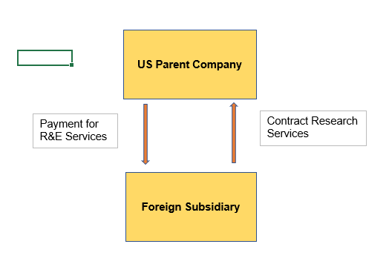
Example #1 – Foreign Research – US Parent Pays CFC
Issue: US parent pays CFC to perform research on its behalf via cost plus arrangement.
Analysis Required: US parent must treat these costs as Section 174 costs subject to 15 year amortization.
Open - Need to determine whether the CFCs must also capitalize under Section 174.

Slide 18
Analogy
Client is building a building. The client would be required to capitalize the building. Client pays a contractor to build the building.
Does the contractor capitalize the building?

Slide 19
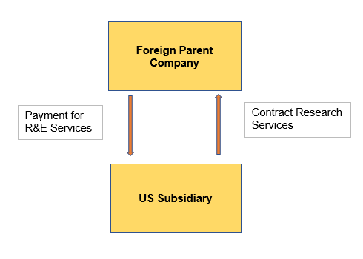
Example #2 – US Inbound
Issue: Foreign related party reimburses, on a cost plus basis, the research services by the U.S. entity. Are the costs incurred by the U.S. entity in connection with those services Section 174?
Analysis Required: The foreign related party pays the U.S. entity on a cost plus basis and the foreign related party retains all the rights to exploit the IP related to the research. Does the U.S. entity need to capitalize costs?

